Slide 1
Techjobs spotlight: most sought-after skills in three major roles.
António, Isabel, Rui

Slide 2
Jobs under the microscope:
Objective: Identify the technical differences between the three.
Data Analyst
Data Engineer
Data Scientist
Source: SELECT linkedin postings web scraped dataset FROM kaggle WHERE usa, ca, aus, uk WHEN 2023/12/17 LIMIT 6025 rows.

Slide 3
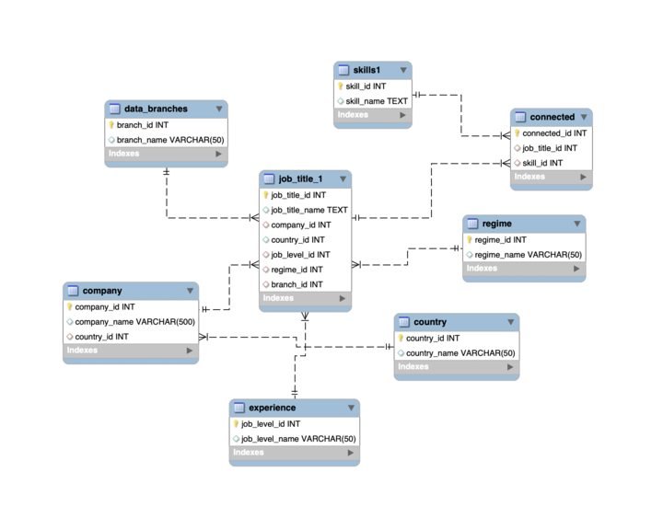
N-ERD

Slide 4
Hypothesis
Can 6500€ really equip you for a Data Analyst career?

Slide 5
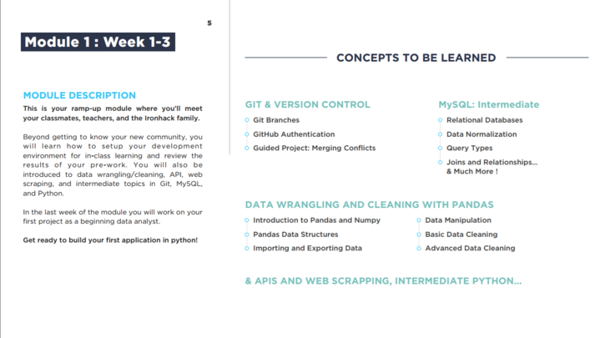
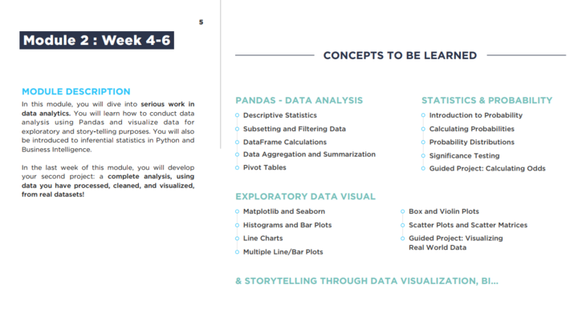
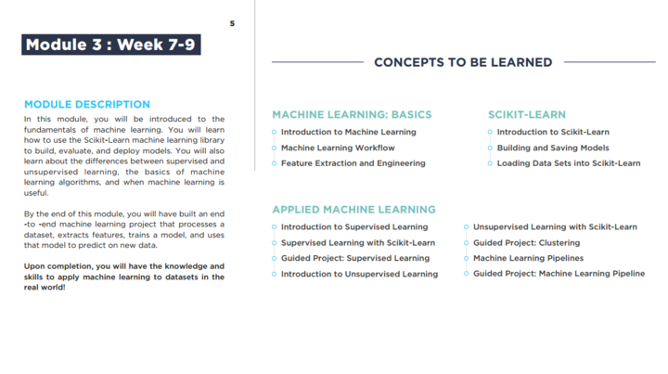


Slide 6
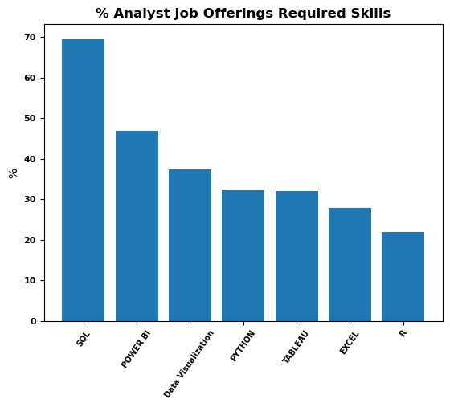







Data Analytics
Top Skills
SQL
POWER BI
DATA VISUALIZATION
PYTHON
TABLEAU
EXCEL
R

Slide 7
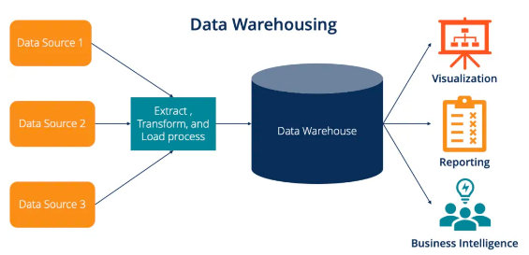
‘Critical Query’
What other skills would we need to acquire in order to navigate between different roles in the data architecture?

Slide 8
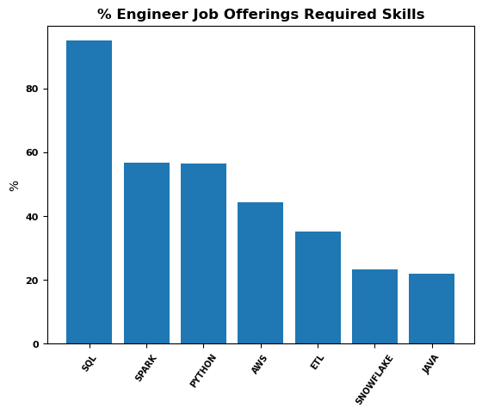





Data Engineering
Top Skills
SQL
SPARK
PYTHON
AWS
ETL
SNOWFLAKE
JAVA

Slide 9
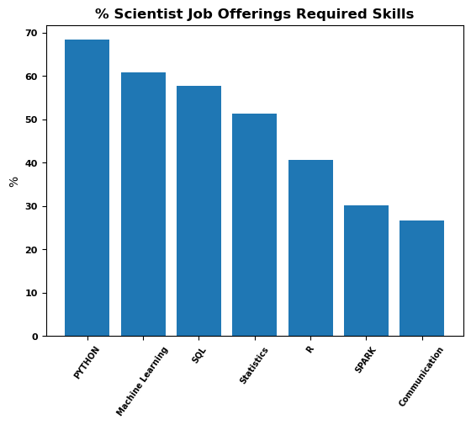



Data Science
Top Skills
PYTHON
MACHINE LEARNING
SQL
STATISTICS
R
SPARK
COMMUNICATION

Slide 10
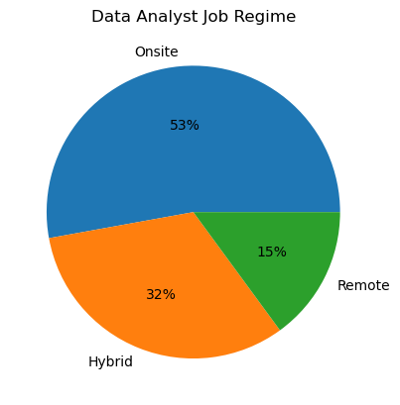
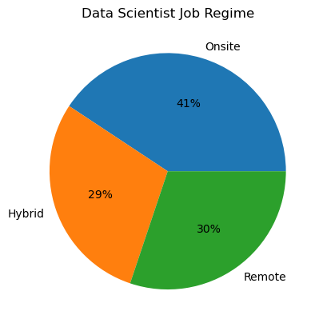
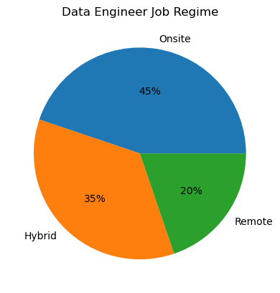
Job regime in Data

Slide 11
Next Steps
Perform web scraping from EU jobs.
Refine the code in Python and SQL in order to update the DB and evaluate skill trends in the data field.

